Slide 1
Expanded Coverage for National Guard and Reserve Members
Updated August 2018
MHS
TRICARE is a registered trademark of the Department of Defense, Defense Health Agency. All rights reserved.
Notes:
Thank you for having me with you today.
This brief provides details on expanding TRICARE coverage for National Guard and Reserve members.

Slide 2
TODAY’S AGENDA
TRICARE IS CHANGING
Coverage During State Disaster Response
ARE YOU READY?
Prepare today!
Notes:
TRICARE is our health care program for uniformed service members and their families around the world.
The vision is for TRICARE to be a world-class health care system that supports the military mission by fostering, protecting, sustaining and restoring health.
The Defense Health Agency, or DHA, is modernizing the Military Health System to better serve our 9.4 million beneficiaries worldwide and respond to changes in law and policy.
On Jan. 1, 2018, there will be several changes to your TRICARE benefit. As a TRICARE beneficiary, you can expect a modernized and easier to understand plan with:
More benefit choices
Improved access to care
Simplified cost-shares, and more
This brief outlines one of the changes you will notice in 2018 and some recent updates to your TRICARE benefit that have already occurred. Today we will talk about expanded coverage for National Guard (NG) members when responding to state national disasters.

Slide 3
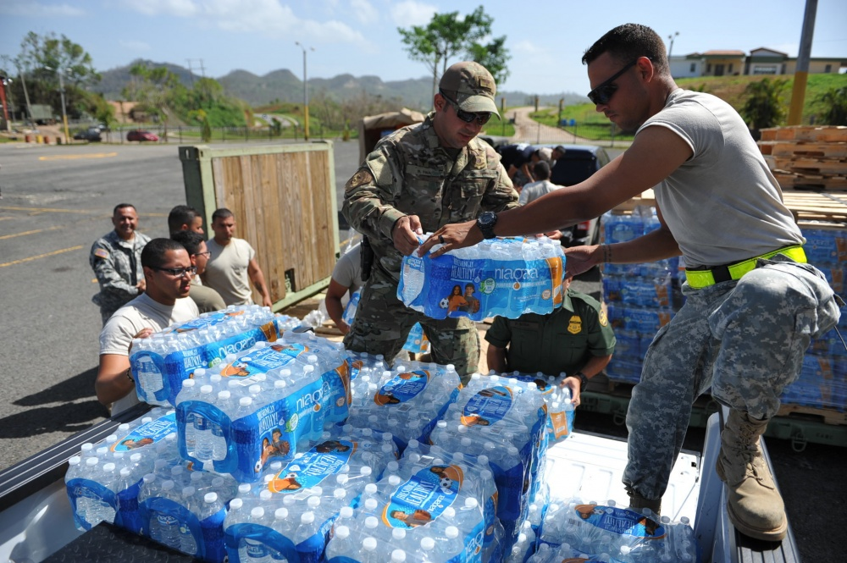
Coverage During State Disaster Response
When placed on state active duty orders for a disaster response, you and your family may be eligible for active duty benefits.
To be eligible:
You must have been on Active Guard Reserve (AGR) duty prior to being called to state active duty orders.
The governor of your state (or the Mayor of the District of Columbia or governor of your U.S. territory) must declare extending coverage and agree to reimburse DoD for all healthcare during the disaster response.
Notes:
When on Active Guard Reserve (AGR) National Guard and Reserve members are considered active duty service members (ADSMs). When placed on state active duty, National Guard and Reserve members may lose their TRICARE eligibility as an ADSM.
However, during certain disaster response duty on state active duty orders, some National Guard and Reserve members and their families may continue to be covered as an ADSM under TRICARE.
Eligibility depends on whether:
The sponsor was on Active Guard Reserve (AGR) duty prior to being called to state active duty orders.
The state governor (or Mayor of the District of Columbia or U.S. territory governor) agrees to reimburse the Department of Defense for TRICARE coverage while National Guard and Reserve members are on state active duty orders.
If you are activated to participate in your state’s response to a natural disaster, check with your unit’s personnel staff to know whether your unit is covered as ADSMs by TRICARE during your deployment.
Note: The National Guard Bureau or your regional contractor will be able to answer questions regarding this benefit.

Slide 4
PREPARE TODAY!
Prepare for the changes now by:
Updating your contact information in the Defense Enrollment Eligibility Reporting System (DEERS) for you and your family
Go to www.dmdc.osd.mil/milconnect
Call 1-800-538-9552 (TTY/TDD: 1-866-363-2883)
Fax updates to 1-831-655-8317
Signing up for email updates at FEDVIP website
Go to http://tricare.benefeds.com and sign up for email updates
Visiting the TRICARE website
Go to www.tricare.mil/changes
Sign up for email alerts about the changes to get an email anytime this page is updated
Notes:
To have more control over your health care, prepare for the upcoming changes to TRICARE by taking the following actions:
Update your contact information in the Defense Enrollment Eligibility Reporting System, or DEERS, for you and your family.
Go to www.dmdc.osd.mil/milconnect.
Call 1-800-538-9552 (TTY/TDD: 1-866-363-2883).
Fax updates to 1-800-336-4416.
Sign up for email updates at FEDVIP website
Go to http://tricare.benefeds.com and sign up for email updates
Visit the TRICARE website.
Go to www.tricare.mil/changes.
Sign up for email alerts about the changes at the link available at www.tricare.mil/changes. You will get an email anytime this page is updated.

