Slide 1
2018 DHA Industry Exchange November 08, 2018 Presenter: Dr. Sean Biggerstaff

Slide 2
J-9 DVBIC Clinical Research Support
Opportunity Description
Contract Details
Contracting Overview
Specifications | Summary
Requiring Activity | Defense and Veteran Brain Injury Center (DVBIC)
Opportunity Title | DVBIC Clinical Research Support
Existing Contract # | W91YTZ-13-C-0015
Opportunity Description | Clinical Research support to DVBIC that supports congressional mandates, provides data driven recommendations to DVBIC leadership and allows for flexibility to fortify partnerships and alliances both internal and external to the Department of Defense that will provide value to the military and veteran communities.

Slide 3
J-9 DVBIC Clinical Research Support
Opportunity Description
Contract Details
Contracting Overview
Specifications | Summary
Contracting Office | NCR-COD
Contract Vehicle | TBD
Contract Type | TBD
Total Contract Duration | Base + 4 option years
NAICS / PSC | 541990
Contract Value Range | $100 – 150M
Small Business Set Aside (Y/N) | N
Contract Start Date | 10 2019

Slide 4
J-9 DVBIC Clinical Research Support
Opportunity Description
Contract Details
Contracting Overview
Provide evidence-based knowledge through conducting and supporting clinically focused research.
Evaluate research processes and programs to improve treatment and outcomes for service members and veterans who have sustained TBI.
Provide state-of-the-science TBI care knowledge by developing clinical recommendations, analyzing outcomes, surveillance reporting, and providing subject matter expertise on TBI-related matters; and assisting service members and veterans in accessing TBI clinical care, supportive services and information throughout the continuum of care.
Provide educational programs, materials and training for healthcare providers, military line leaders, veterans, families and civilian communities on awareness, prevention, diagnosis, treatment and management of TBI.

Slide 5
J-9 Program Management Support
Opportunity Description
Contract Details
Contracting Overview
Specifications | Summary
Requiring Activity | DHA Research & Development (J-9)
Opportunity Title | Program Management Support
Existing Contract # | W81XWH-08-D-0045
Opportunity Description | This opportunity provides support for Correspondence Management, Operations, Human Resources, Facilities, Logistics, Program Management, Training, and Business Management for the DHA Research and Development Directorate (J-9).

Slide 6
J-9 Program Management Support
Opportunity Description
Contract Details
Contracting Overview
Specifications | Summary
Contracting Office | USAMRAA
Contract Vehicle | OASIS – Small Business
Contract Type | FFP
Total Contract Duration | Base + 4 option years
NAICS / PSC | 541611
Contract Value Range | $20 - 25M
Small Business Set Aside (Y/N) | Yes
Contract Start Date | 12 2018

Slide 7
J-9 Program Management Support
Opportunity Description
Contract Details
Contracting Overview
Specific Task: Support for Correspondence Management, Operations, Human Resources, Facilities/Logistics, Program Management, DHA Training Management, Business Management and expert support for the Defense and Veterans Brain Injury Center for the DHA Research and Development Directorate (J-9).
Bidders need to describe what experience they have had in support of these task and provide examples of that support.

Slide 8
J-9 HCE Research Coordination
Contract Details
Opportunity Description
Additional Information
Contracting Overview
Specifications | Summary
Requiring Activity | Hearing Center of Excellence (HCE)
Opportunity Title | HCE Research Coordination
Existing Contract # | W81XWH-15-D-0011 TO 0003, W81XWH-15-D-0011 TO 0004, W81XWH-15-D-0011 TO 0005, W81XWH-15-D-0011 TO 0009, W81XWH-15-D-0011 TO 0010, W81XWH-15-D-0014 TO 0002
Opportunity Description | Provide support to the HCE in the areas of research, clinical care and prevention to meet the requirements of NDAA 2009, Section 721, Established the HCE.

Slide 9
J-9 HCE Research Coordination
Contract Details
Opportunity Description
Additional Information
Contracting Overview
Specifications | Summary
Contracting Office | USAMRAA
Contract Vehicle | HCE PASS
Contract Type | IDIQ
Total Contract Duration | Base + 4 option years
NAICS / PSC | 541990
Contract Value Range | $15 - 20M
Small Business Set Aside (Y/N) | Yes
Contract Start Date | 02 2019

Slide 10
J-9 HCE Research Coordination
Contract Details
Opportunity Description
Additional Information
Contracting Overview
Vendor will be providing overarching support to the Research Coordination, Clinical Care and Prevention branches of the HCE:
The Prevention and Surveillance Branch is the pillar of HCE’s core objective to prevent hearing loss among Warriors and Service members, and Veterans.
The Clinical Care, Rehabilitation & Restoration Branch ensures all members of the Armed Forces and Veterans suffering from hearing loss or auditory-vestibular injury receive comprehensive, coordinated, high-quality treatment.
The Research Coordination Branch seeks to unify DoD, VA, academic and industry research initiatives and to achieve common clinical research objectives.

Slide 11
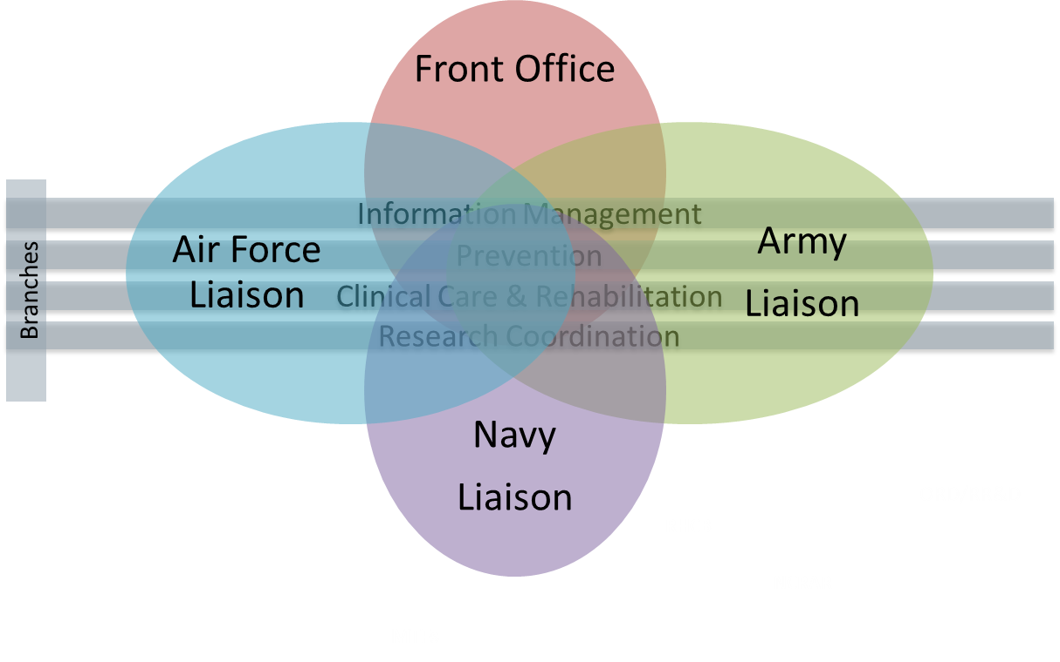
J-9 HCE Research Coordination
Contract Details
Opportunity Description
Additional Information
Contracting Overview
A vendor needs to understand the HCE mission, vision and goals and how it aligns to the DHA mission. Also, reviewing the NDAA 2009, Section 721 and the HCE website (https://hearing.health.mil/) will give the vendor additional insight.

